Slide 1
Unit 1

Slide 2
What we are going to cover
Cloud Service Delivery Models and their details

Slide 3
After completing this unit, you should be able to
Understand the characteristics of IaaS
Gain knowledge on the characteristics of PaaS and the integrated lifecycle platform
Gain an insight into the characteristics of SaaS
Understand the different types of SaaS platform

Slide 4




Cloud Delivery Model
The nature of services delivered by cloud is called cloud delivery model.
A cloud service layer determines the nature and particulars of services delivered by a particular cloud solution.
Cloud delivery model is different from the deployment model as deployment model determines how cloud is implemented but not the kind of services it provides.

Slide 5




Cloud Delivery Model
A typical cloud-based IT infrastructure is composed of four major IT layers:
Infrastructure Layer provides services in the form of storage pool, VMs, Network bandwidth etc.
Platform (middleware) Layer provides installed and configurable OS to run a third-party applications or a development environment.
Software (applications) Layer provides the web-based access to commercial applications.
Business Process Layer provides specialized business applications & services.

Slide 6


Cloud Delivery Model
Each of IT layers can be delivered as a service to the end customers.
Based upon this, the cloud delivery models are broadly divided into 4 major categories:
IaaS (Infrastructure as a service)
PaaS (Platform as a service)
SaaS (Software as a service)
BPaaS (Business Process as a service)

Slide 7
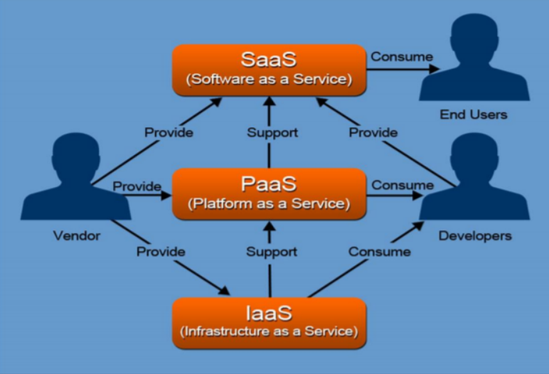
Cloud Delivery Model

Slide 8
Infrastructure as a Service
IaaS (Infrastructure as a service)
Cloud services that deliver infrastructure resources like compute (CPU, Memory), storage, network bandwidth, load balancer, disaster recovery, backup hardware etc. are known as Infrastructure as a Service (IaaS).
As with any service on cloud, IaaS is provided with a pre-defined SLA to the end customer.

Slide 9



Infrastructure as a Service
IaaS (Infrastructure as a service) Characteristics
Virtualization: Hypervisor and virtualization is the central concept of IaaS. Virtualization is an enabler for the cloud. Virtualization creates an abstriction of the underlying hardware and makes it more flexible and manageable. The first step in deploying IaaS based services is to consolidate using virtualization before transferring to cloud.
Cloud bursting: The concept of automatic scaling of the cloud based on the load is called cloud bursting. Cloud bursting is a configuration method that uses cloud computing resources whenever on-premises infrastructure reaches peak capacity. When organizations run out of computing resources in their internal data center, they burst the extra workload to external third-party cloud services.

Slide 10


Infrastructure as a Service
IaaS (Infrastructure as a service) Characteristics:
Multitenancy: In cloud computing, multitenancy means that multiple customers of a cloud vendor are using the same infrastructure resources on sharing basis. It allows efficient use of spare capacity on the cloud.
Resource Pooling: It involves pooling up of the physical server resources and sharing of these resources among multiple users on demand basis.

Slide 11


Infrastructure as a Service
IaaS (Infrastructure as a service) Example
Amazon EC2
Rackspace Cloud
GoGrid
MediaTemple
GridLayer
Flexiscale
Joyent

Slide 12
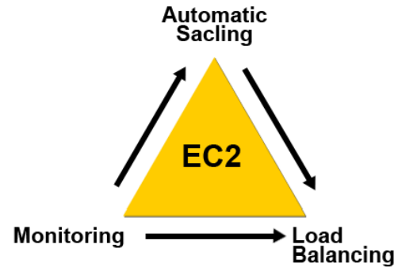



Infrastructure as a Service
Amazon EC2 Case Study
Computing facility
Operating systems
Persistent storage
Elastic IP addresses
Monitoring
Automated scaling

Slide 13
AWS Elastic Compute Cloud (EC2)
EC2 uses XEN (open-source hypervisor) for creating VM
Amazon EC2 provides scalable computing capacity in the AWS cloud.
You can use EC2 to launch as many or as few instances as you need, configure security and networking, and manage storage.
EC2 enable you to scale up and scale down instances.
Pre-configured templates of EC2 instances are available which are known as Amazon Machine Image.

Slide 14
AWS EC2 Instance Types
General Purpose: Balanced Memory & CPU
Compute Optimized: More CPU than RAM
Memory Optimized: More RAM
Storage Optimized: Low latency
High Memory: High RAM on Nitro system
Accelerated Computing/GPU: Graphics optimized

Slide 15
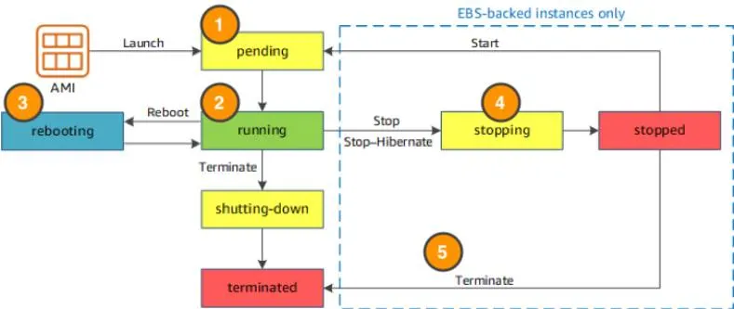

AWS EC2 Instance Life Cycle

Slide 16







AWS EC2 Instance Life Cycle
When you launch an instance, it enters the pending state (1). When the instance is pending, billing has not started. At this stage, the instance is preparing to enter the running state.

Slide 17









AWS EC2 Instance Life Cycle
When your instance is running (2), it's ready to use. This is also the stage where billing begins. As soon as an instance is running, you are then able to take other actions on the instance, such as reboot, terminate, stop, and stop-hibernate.

Slide 18














AWS EC2 Instance Life Cycle
When you reboot an instance (3), it’s different than performing a stop action and then a start action. Rebooting an instance is equivalent to rebooting an operating system. The instance remains on the same host computer and maintains its public and private IP address, and any data on its instance store.
Private IP address of a system is the IP address that is used to communicate within the same network. Public IP address of a system is the IP address that is used to communicate outside the network.

Slide 19













AWS EC2 Instance Life Cycle
When you stop and start an instance (4), your instance may be placed on a new underlying physical server. Therefore, you lose any data on the instance store that were on the previous host computer. When you stop an instance, the instance gets a new public IP address but maintains the same private IP address.

Slide 20










AWS EC2 Instance Life Cycle
When you terminate an instance (5), the instance store are erased, and you lose both the public IP address and private IP address of the machine. Termination of an instance means you can no longer access the machine.

Slide 21

AWS EC2 Instance Life Cycle
When you launch an instance, it enters the pending state (1). When the instance is pending, billing has not started. At this stage, the instance is preparing to enter the running state.
When your instance is running (2), it's ready to use. This is also the stage where billing begins. As soon as an instance is running, you are then able to take other actions on the instance, such as reboot, terminate, stop, and stop-hibernate.
When you reboot an instance (3), it’s different than performing a stop action and then a start action. Rebooting an instance is equivalent to rebooting an operating system. The instance remains on the same host computer and maintains its public and private IP address (Private IP address of a system is the IP address that is used to communicate within the same network. Using private IP data or information can be sent or received within the same network. Public IP address of a system is the IP address that is used to communicate outside the network.), and any data on its instance store.
It typically takes a few minutes for the reboot to complete. When you stop and start an instance (4), your instance may be placed on a new underlying physical server. Therefore, you lose any data on the instance store that were on the previous host computer. When you stop an instance, the instance gets a new public IP address but maintains the same private IP address.
When you terminate an instance (5), the instance store are erased, and you lose both the public IP address and private IP address of the machine. Termination of an instance means you can no longer access the machine.

Slide 22
AWS EC2 Storage Options
Two types of block store devices are available for EC2 instances:
Elastic Block Storage
Instance Storage

Slide 23
ISP → IaaS
Usually, we consider the emergence of IaaS when Amazon launched its Electric Cloud Computing (EC2) service in 2006.
But long before then, Internet service providers (ISPs) were happily renting out servers to companies. There is lot of similarity between ISP and IaaS business model.
Both rent infrastructure for the purpose of running applications.
Infrastructure as a service is the maturation of the ISP model.
The key difference is the addition of new technologies such as virtualization and well-defined self-service management interfaces.

Slide 24
Motivation for renting the infrastructure
Price
Aggregation of resources
Speed to deployment
Security

Slide 25
IaaS Enabling Technologies
The ability to offer IaaS requires software that can manage the infrastructure that’s being shared. In this area, two technologies are worth drawing attention to:
AppLogic from 3Tera
Eucalyptus, an open-source initiative

Slide 26
IaaS Enabling Technologies-Applogic
3Tera, Inc., was founded in 2004 to develop system software for cloud computing.
In February 2006, it launched its AppLogic product, which has since been taken up by many service providers and cloud computing vendors.
AppLogic is a management software that converts arrays of servers into virtualized resource pools that can be shared among multiple users.
The software enables users not only to create and destroy virtual machines but also to define necessary infrastructure such as firewalls, VPNs, load balancers, and storage by using a browser interface. AppLogic enables the configuration of
Virtual private servers
Cloud data storage
Software as a Service (SaaS) applications

Slide 27
IaaS Enabling Technologies-Eucalyptus
Eucalyptus is a forced acronym standing for Elastic Utility Computing Architecture.
Eucalyptus is open-source software.
Eucalyptus is a system for implementing on-premise private and hybrid clouds, using the hardware and software infrastructure that’s in place, without modification.
It’s an add-on capability for data center virtualization to create genuine cloud capability such as self-service provisioning, security, performance management, and end-user customization.

Slide 28
Trusted Cloud
CSC, the global systems integration company, has recognized this issue of unfamiliarity with using cloud-based services and first used the term Trusted Cloud to define the kind of environment that many organizations would want and expect from a cloud service provider. The trusted cloud includes services that are:
Secure
Transparent of control and result (whether it provides a full customer interface so that you can see how everything functions)
Able to provide evidence that systems operate as advertised (whether it meets the services levels it is supposed to be providing)
Trusted cloud is like what outsourcing to specialists and managed service providers offer.

Slide 29
IaaS is best suited
Where the organization grows rapidly, and hardware escalation would be problematic due to infrastructure limitations.
Where there is pressure on the organization to limit capital expenditure and move to operational expenses.
For new organizations without capital investment in hardware (to avoid CapEx).
For specific needs of the business line, test or temporary infrastructure.
Where demand is very volatile: Each time there are significant peaks and valleys in terms of demand in the infrastructure.

Slide 30
IaaS is not best suited
Where the highest levels of performance are required, and the infrastructure hosted on the site or dedicated can meet the needs of the organization.
When regulatory compliance hinders the transfer or outsourcing of data storage and processing.

